Slide 1
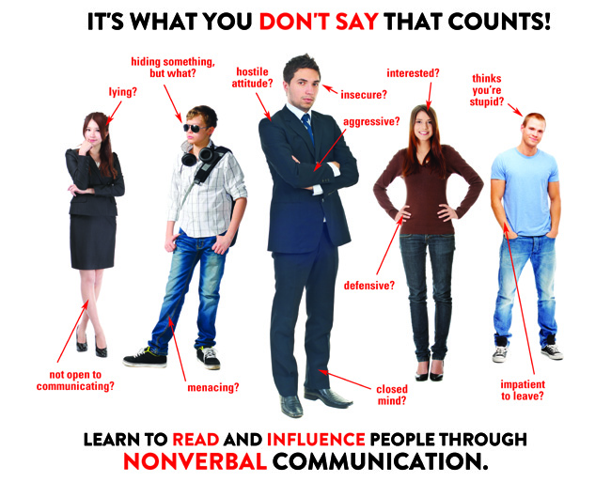
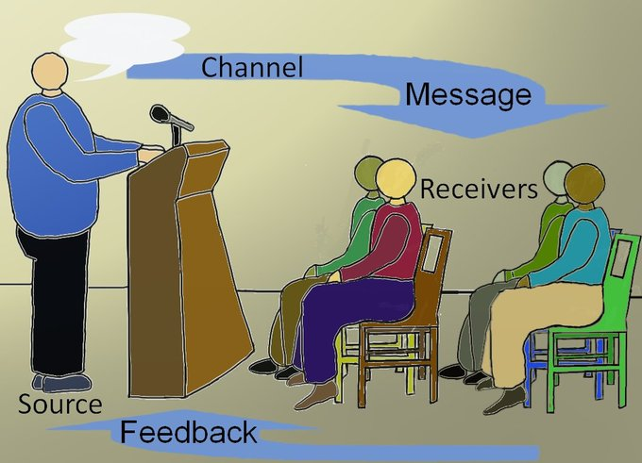
Verbal and non-verbal communication
Compiled by group 4
Muzaki tracy
Abbo Florence
Nakyejjwe flavia
Annet balinabyo
Nabawanga shadiah

Slide 2
definitions
Communication is the process by which information is exchanged between individuals through a medium.
Verbal communication is the process of conveying information through written and spoken words.
Non-verbal communication is the process of conveying information without the use of words.

Slide 3
tYPES of verbal and non-verbal
Verbal communication
Non-verbal communication
Oral communication
Written communication
Body language
Paralanguage
Personal presentation
Proxemics
Sign language

Slide 4
Verbal communication
Oral
This simply refers to conveying messages through spoken words direct from the mouth. Examples include telephone conversations, face to face conversations among others.
Written
This is the process of conveying messages in written form. Examples include, letters, memos, reports, E-mails among others.

Slide 5

Verbal communication image

Slide 6
Non-verbal communication
Body language
This involves use of body parts to convey information without speaking.
It includes; Facial expressions, Eyes, Gestures, Body shape, Posture, Appearance.
Paralanguage
This allows people to add layers of meaning to their spoken utterances through the manipulation of the manner of speech, or the way the say things.

Slide 7
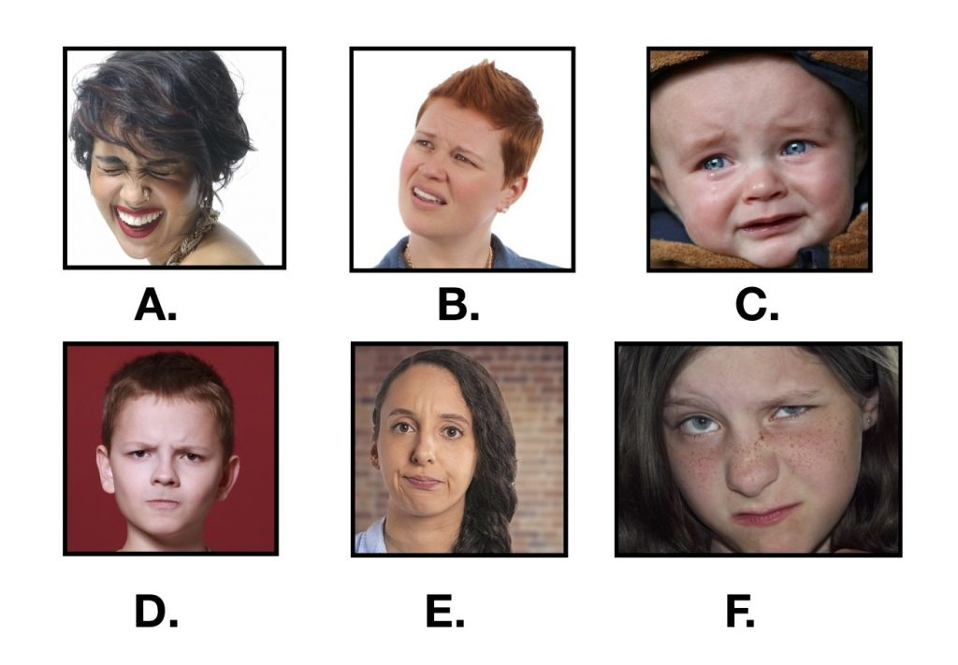
Nonverbal communication image

Slide 8
Non-verbal cont’d
Personal presentation
This mainly deals with one’s public display of who they are and what they want to communicate. It can be in terms of clothing, grooming and touching.
Proxemics
This mainly concerns the use of space while communicating. It includes Intimate distance(0-18inches), Personal distance(18 inches to 4 feet), social distance(4 to 12 feet), public distance(12 to 25 feet)
Sign language
This mostly deals with the deaf, involves the use of hands to make symbolic gestures which have specific meaning like finger spelling.

Slide 9
Comparison between verbal and non-verbal communication
verbal
Non-verbal
Exchange of information without the use of words.
Uses facial expressions, body language, to communicate with others.
Decoding is complicated since more attention is needed
Does not require thinking deeply while expressing his or her views non-verbally.
Exchange of information with the use of words either spoken of written.
Uses words, voice, sentences and language to communicate.
Easy to understand
Includes more awareness because one needs to analyse before speaking

Slide 10
Applications of verbal and non-verbal
NB- Most applications of both verbal and non verbal communication cut across, because we use verbal with non-verbal communication in our daily lives un-knowingly.
And these include;
Training sessions
Presentations
Group meetings
Interviews
Consultation engagement
One-on-one discussions

Slide 11
Benefits of Verbal and Nonverbal communication
Feedback can be given or taken immediately.
Both the message sender and the receiver are available during the communication.
Correction can be made instantly.
Loss or harm can be prevented easily.
Body language helps to accompany the verbal communication.
Nature of Receiver :When addressing hearing impaired people, sign language is key.
Response to visuals and plain sounds is more powerful than to language.

Slide 12
references
You can visit the following sites for more information
Siaya institute of technology
Study.com
Resume skills for jobs.com
The master reference is GOOGLE

Slide 13
Thank you for listening

